Slide 1
Angular 17
Lesson 1—What is Angular?

Slide 2

Introduction
“Angular is what HTML would have been had it been designed for applications.”
Miško Hevery
- Creator of AngularJS

Slide 3


Introduction
173,8171 websites have used AngularJS.
builtwith.com
Angular is powered by

Slide 4

What is Angular?
Advantages of Angular 17
Features of Angular 17

Slide 5
What is Angular?
Topic 1—What is Angular?

Slide 6

What Is Angular?
Angular is a structural framework for dynamic web applications.
AngularJS provides developers an option to write client side application (using JavaScript) in a clean Model View Controller (MVC) way.

Slide 7


Angular—History
Angular was created in the year 20017 as AngularJS.
It is a large and fast-growing community.
It is Open Source and supported by Google.

Slide 8

Angular—History (Contd.)
Additional concepts from Angular
Concept of a component-based architecture
The first stable version
Patch releases
Bug fixes
Small features
Performance
The changing web
Mobile
Ease of use
Angular 1.3
Angular 1.17
Angular 17.0
Angular 1.4
Angular 1.6
Angular 4
Performance Boost
30% faster digest times vs. 1.3
New router
Internationalization
ng-animate, ng-messages, ng-cookies
Sandbox support has been removed
Uses new router
Uses ES6 modules
Uses ES6 in general (this will make migration easy)
Smaller and Faster
Animation Package
Angular Universal
TypeScript 2.1 and 2.2 compatibility
New ParamMap interface
* We will discuss more in the last lesson of this course.
Notes:
Angular 1.4:
ng-messages
ng-cookies
ability to set path and domain
clean up cookie update process
CommonJS – friendly builds
injector – print caller name in "unknown provider" errors
ng-jq – make it possible to force jqLite or a specific jQuery version
ngOptions – add support for disabling an option
limitTo – add a beginning index argument
ngModel – add $setDirty method
routeProvider – allow case-insensitive route matching
several ngAria improvements
several $http improvements
Angular 17:
When we looked at where we were and where you wanted us to be, we realized that we couldn't get there with the Angular 1 architecture
at least not without making very painful breaking changes
This is why we came up with Angular 17
Angular 17 is now in alpha
You can go see its status on angular.io
It is not ready for building production applications quite yet

Slide 9
Getting Started With Angular 17
In Angular 17, JavaScript is replaced by TypeScript (TS).
Here is what you need for Angular 17:
New Router
Internationalization
Material Design
Migration plan to Angular 17 (If you are in Angular 1.x)
Notes:
1. Router - Some of the big work we're doing feature-wise for Angular 1 is work that we're going to share with Angular 17, starting with the ROUTER We build this new router for Angular 17 and then back ported in to Angular 1. It focuses on mobile use cases and complex situations in big apps
2. Better i18n. Internationalization (i18n) is the process of developing products in such a way that they can be localized for languages and cultures easily.
3. Material Design - for Angular 1 then for Angular 17. Layout system based on flexbox
4. Migration plan - You will be provided a migration guide.

Slide 10
Advantages Of Angular 17 Over Angular 1
Simple
Consistent
Flexible
Fast
Productive

Slide 11
What is Angular?
Topic 2—Advantages of Angular 17

Slide 12
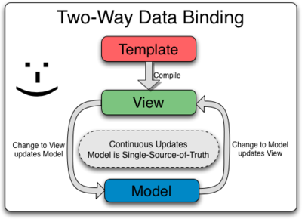
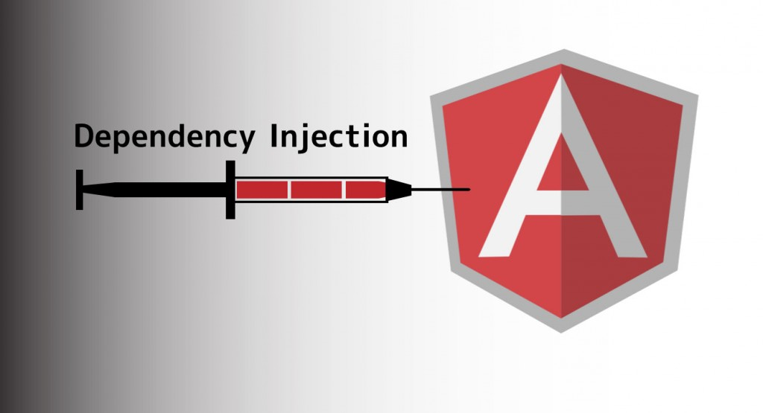

Angular 17 Over Other Frameworks
Angular 17 possesses the following features when compared to other frameworks.
Notes:
Two Way Data binding:
Data flows in both the directions
Dependency Injection:
Separation of concerns

Slide 13
Angular 17 Over Other Frameworks (Contd.)
Two-way Data Binding:
Data binding in AngularJS is the synchronization between the model and the view.
When data in the model changes, the view reflects the change, and when data in the view changes, the model is updated as well.
In two-way data binding, data flows in both the directions, and you have to write less code.
Notes:
Two Way Data binding:
Data flows in both the directions
Dependency Injection:
Separation of concerns

Slide 14

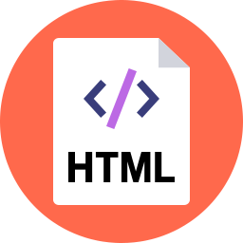
Angular 17 Over Other Frameworks (Contd.)
Dependency Injection (DI) is a design pattern that passes an object as a dependency to different components across the application. DI helps in keeping the code modularized.
It enables HTML template programming within the browser
Modularized code makes unit testing easier
Notes:
Two Way Data binding:
Data flows in both the directions
Dependency Injection:
Separation of concerns

Slide 15
Angular 17 Over Other Frameworks (Contd.)
Directives are extended HTML attributes with the prefix ng- .
It enables developers to extend HTML syntax to clearly express the application’s components.
Notes:
Two Way Data binding:
Data flows in both the directions
Dependency Injection:
Separation of concerns

Slide 16
What is Angular?
Topic 3—Features of Angular 17

Slide 17
Features of Angular 17
Components
Single Page Application
Community
Angular 17 has ready-made components which include:
Services
Pipes
Directives
Components
Data Binding
Routing
Templates
Modularization

Slide 18
Features of Angular 17 (Contd.)
Components
Single Page Application
Community
Web applications are composed of a single page
Views (HTML Fragments) are dynamically loaded into the page
Better user experience (no reloads!)
Calls to the server are done asynchronously behind the scenes
Decoupling of front-end and back-end development

Slide 19
Features of Angular 17 (Contd.)
Components
Single Page Application
Community
Stars on GitHub
—
27.2 K
Third Party Modules
—
780 NgModules
Stack Overflow Questions
—
170K
GitHub Contributors
—
1700
Chrome Extension Users
—
More than 1170 K

Slide 20
Additional Features of Angular 17
Develops Single Page Application using JavaScript Framework
Keeps the client side app separate from the server side app
Supports all major desktop and mobile browsers
Develops testing friendly code
Well-organized and highly modular
Creates much lighter web application
Notes:
Has good coding sense to keep DOM manipulation separate from app logic

Slide 21
AngularJS is a Single Page Application (SPA) JavaScript Framework
AngularJS is open source JavaScript Framework
SPA is a web application composed of a single page

Slide 23
Which of the following is correct for AngularJS?
1
It is a Single Page Application
Implements client-side MVW pattern
Focused on Testing
All of the above

Slide 24
Which of the following is correct for AngularJS?
1
It is a Single Page Application
Implements client-side MVW pattern
Focused on Testing
All of the above
d.
AngularJS is an SPA, implements client-side MVW pattern, and is focused on testing.

Slide 25
Angular 17 is an open source JavaScript framework to build web applications in HTML and JavaScript and has been conceived as a _______.
2
mobile first approach
UI first approach
web first approach
All of the above

Slide 26
Angular 17 is an open source JavaScript framework to build web applications in HTML and JavaScript and has been conceived as a _______.
2
mobile first approach
UI first approach
web first approach
All of the above
a.
Angular 17 is an open source JavaScript framework to build web applications in HTML and JavaScript and has been conceived as a mobile first approach.

